Slide 1
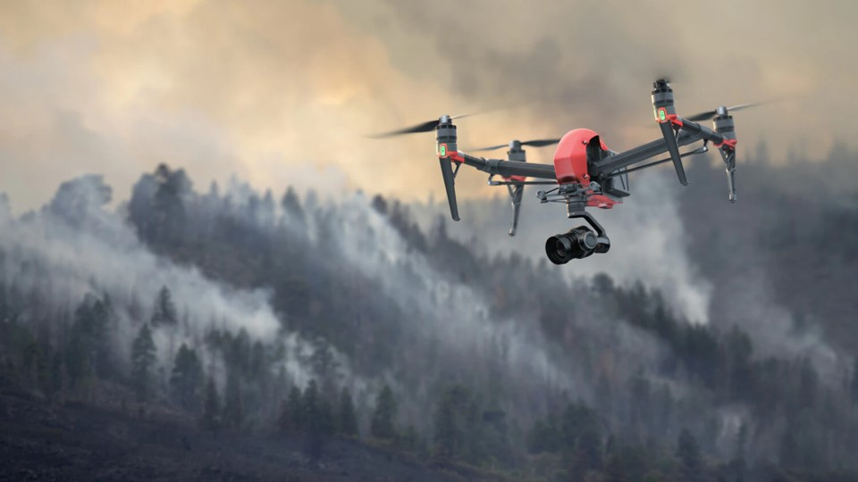
GROUP 40: SEARCH & RESCUE DRONE
Notes:
Lisa

Slide 2
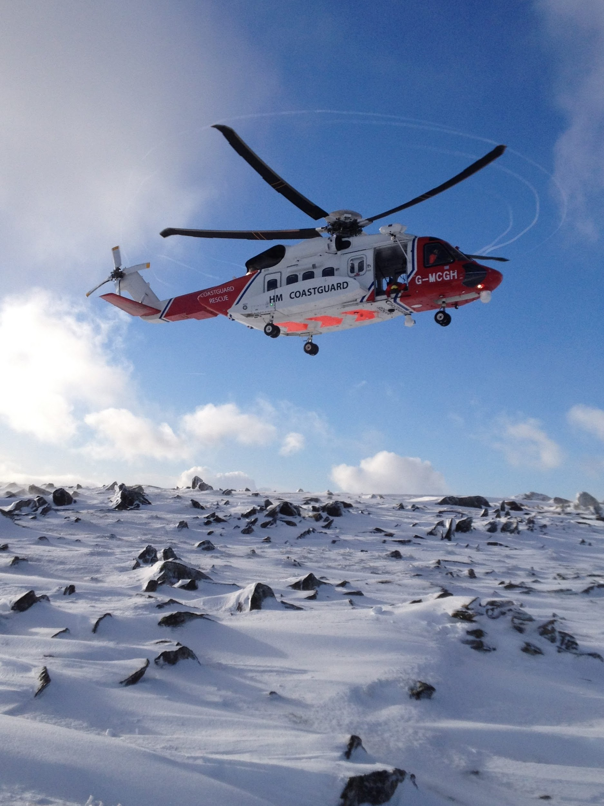
The Problem
SAR crews are often compelled to enter risky or hazardous environments to rescue victims
This puts human lives in jeopardy when there’s no guarantee humans are within the search perimeter
Great risk for no guaranteed reward
Workarounds do exist in the form of drones, but there are drawbacks:
Ground-based drones aren’t viable options over very rough, uneven terrains
Aerial drones are often manned, and thus require a licensed pilot(s) to be a part of the crew
Notes:
Lisa

Slide 3
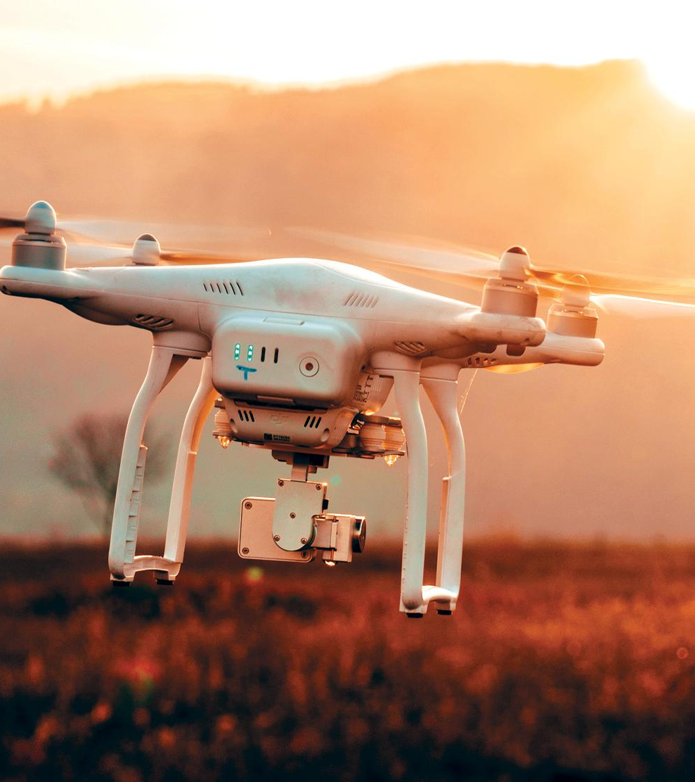
Our Mission
Minimize operator risk with autonomous drones.
Create an end-to-end platform that searches a user-defined search area for humans:
Ground system application
Drone
Camera system
CV algorithm
Return a geographical coordinate location and image when potential human detected
Notes:
Lisa; expand second bullet point verbally

Slide 4
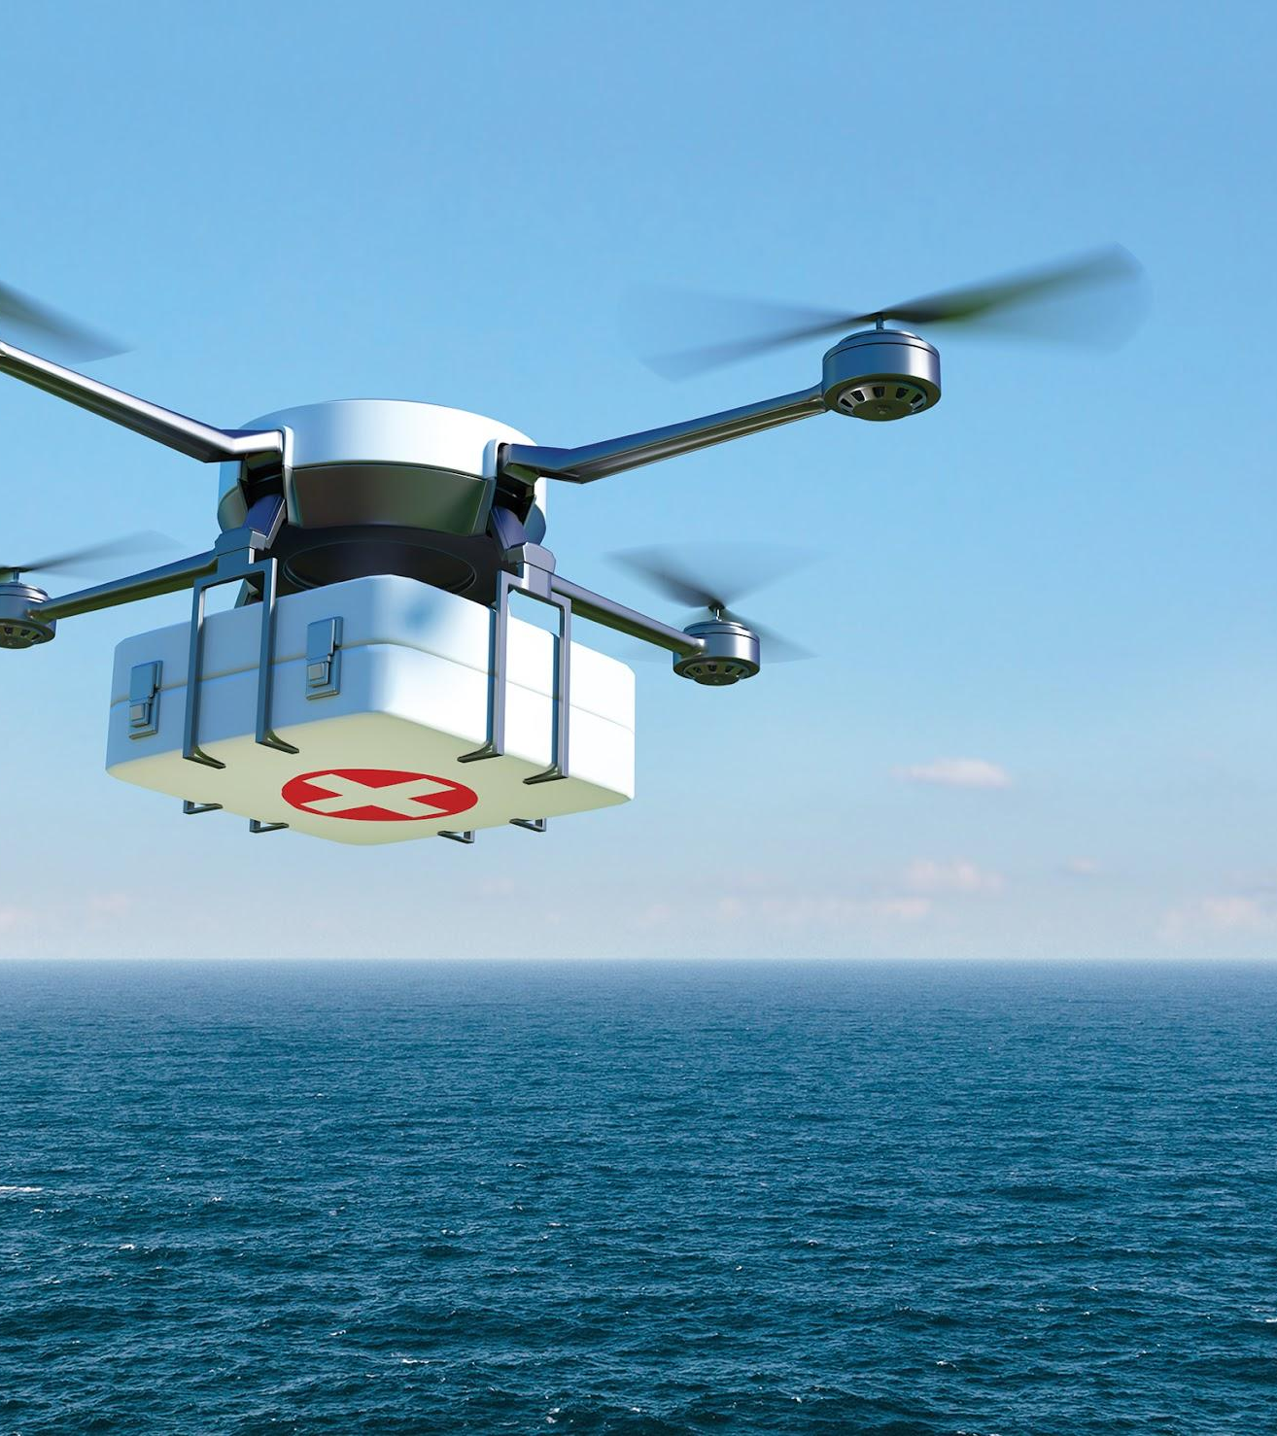
Mission Requirements
Search area 150 ft x 150 ft
12 minutes flight time
Enough to cover entire search area
Adequate CV footage
Identify human victim with 80% confidence
Carry up to 1 lb cargo
Flight speed > 15 mph
Search speed = 10 mph
Notes:
Lisa

Slide 5
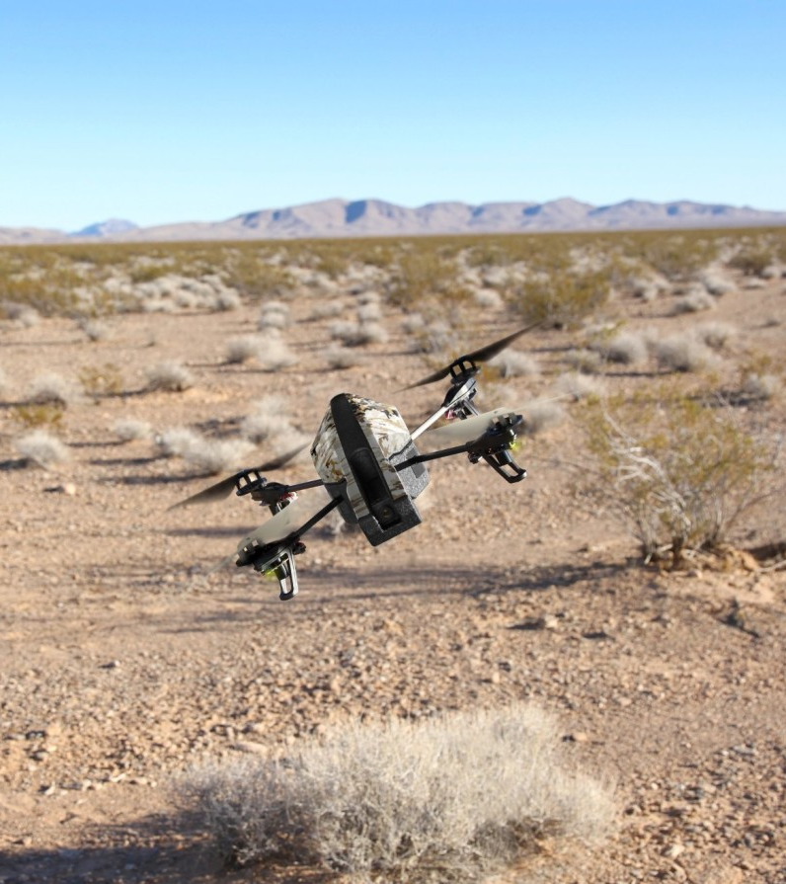
Use Case
Search area roughly the size of half a football field (150 ft x 150 ft)
Level terrain with no obstacles
Lays foundation for operations in contemporary military theatres
Desert
Rubble field
Open water
Toxic Environments
First step towards comprehensive SAR drone
Obstacle avoidance
Additional sensors
Supply delivery
Notes:
Lisa

Slide 6
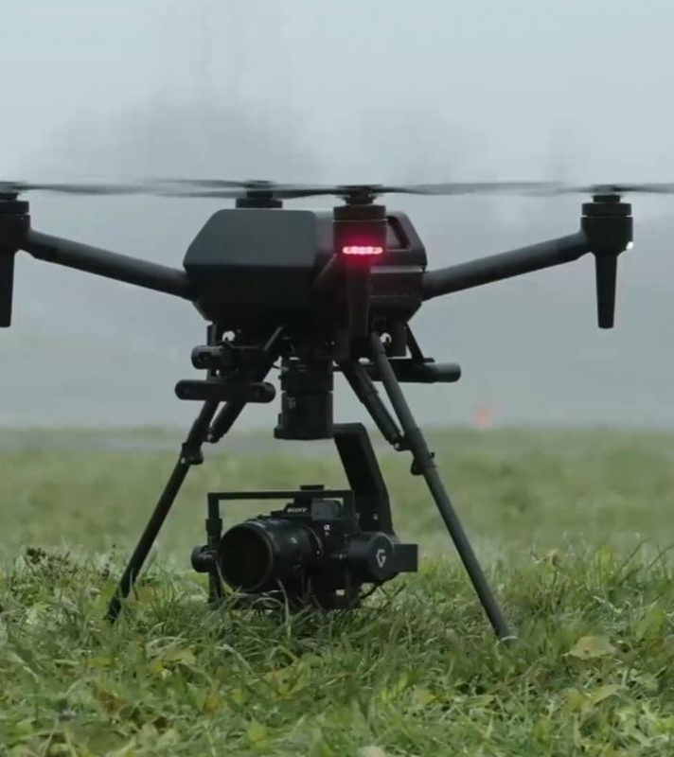
Flight Hardware
Notes:
Speaking: Nick, Joey

Slide 7

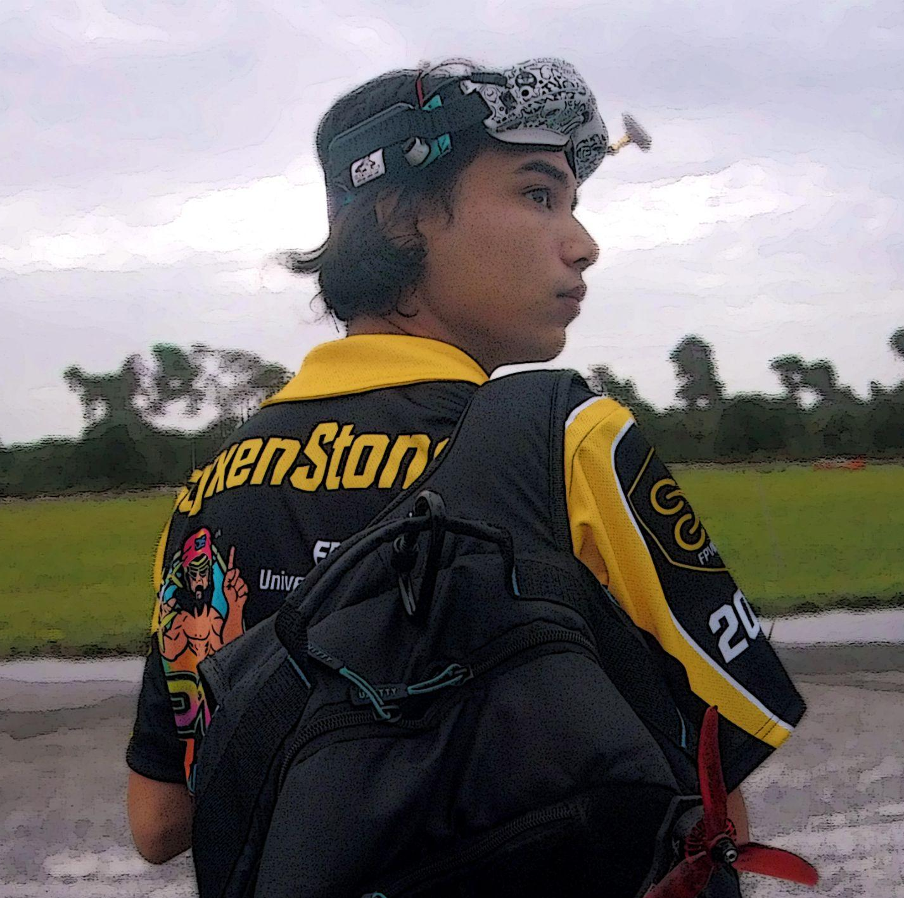
Hardware System Members
Nick Norman (ME)
Joey Manalo (CS)
Project Manager
Drone Frame design, mounting hardware design and manufacturing
Drone SME (Subject Matter Expert)
Drone Component Selection
Lead Tester and Builder

Slide 8
Hardware System Requirements
Mission requirements
Search area of 150 feet x 150 feet 12 minute operation run time Provide adequate CV footage Ability to carry up to 1 lb of cargo Vehicle max velocity greater than 15mph Searching speed of 10mph
Objectives
Portability Weight reduction Reduce jitter for CV models in live footage
Additional Requirements
Frame must be built, not purchased Mechanical Engineering SD requirement Senior Design Budget - $500
Notes:
Split into the beginning of each system?

Slide 9




Design Options
Option A: Tracked Vehicle | Option C: Fixed Wing UAV
~$250 for 1:16 R/C Independent motor control for each track, off-road, nimble, cargo Turret control (camera view) No cargo limitations Best choice for LBV navigation | ~$120 for consumer-grade UAV no topographical limitations Superior camera view High speed and repeatable flight patterns Up to 45 minute flight time Cannot fly backwards or hover
Option B: 4-Wheel 4X4 Vehicle | Option D: Multi-Rotor Drone
$100-430 decent off-road, speed maneuvers using two axles No cargo limitations, speed | ~$300 for 7” quadcopter no topographical limitations Superior camera view Best maneuverability, hovering 10 - 20 minute average flight time

Slide 10
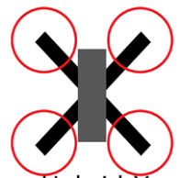
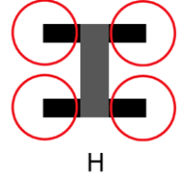
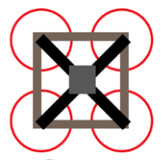

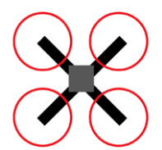
Important Design Considerations - Frame
Frame Type: | True X | Hybrid X | H-Frame | Square | Stretched X
5” Drone Weight | 66g | 104-156g | 104-156g | 80 - 91g | 65 - 72g
Component placement (symmetry) | completely centered | semi centered | semi centered | completely centered | completely centered
Available cargo space | 2nd | 1st | 1st | 2nd | 2nd
landing gear placement | 1st | 2nd | 2nd | 1st | 3rd

Slide 11
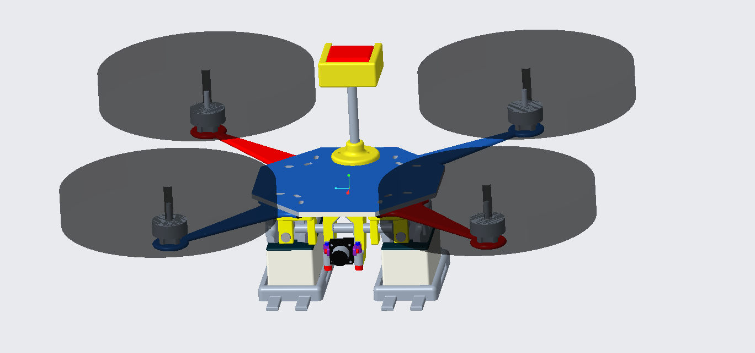
X- Frame Components
Carbon Fiber Drone Frame
Tactical Rail System (TRS)
Tactical Camera Mount (TCM)
Tactical GPS Mount (TGM)
Battery Landing Gear (BLG)

Slide 12
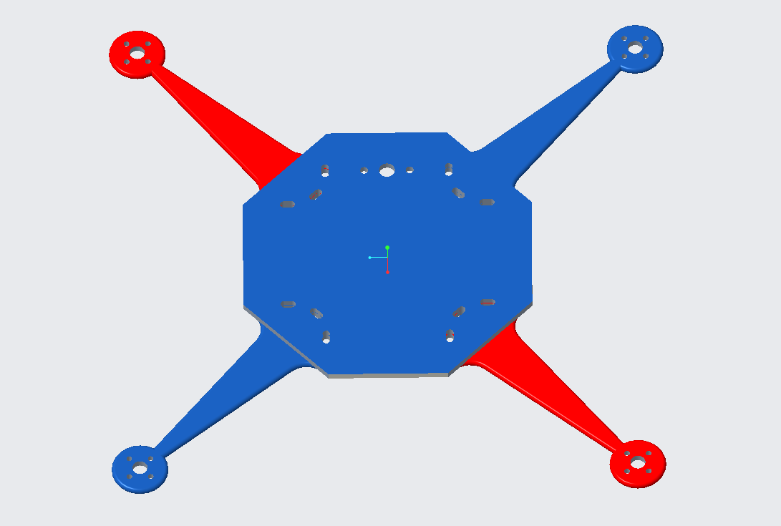
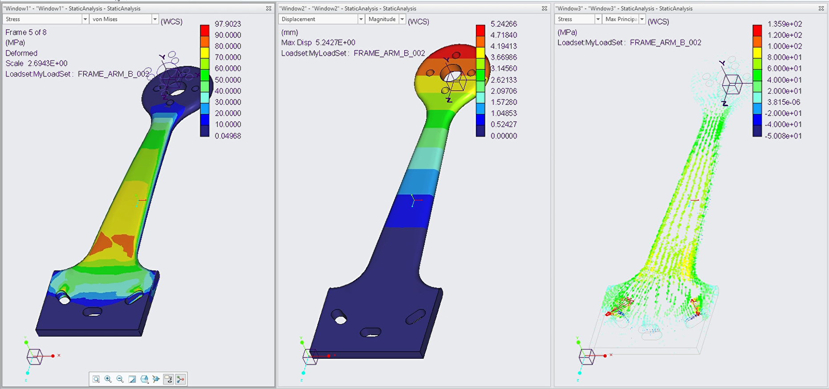
Carbon Fiber Frame
3K Plain Weave Carbon Fiber Frame
4mm thick
Separate arms
Replacements
Octagon center plate
Increased connectable surface
Symmetrical
Component | Beginning Weight (g) | Final Weight (g)
Center Plate | 103.4 | 103.4
Arm (x 4) | 71 | 16.2
Notes:
Plain weave is stiff, and suited for frames and otherwise rigid structures. The properties of a carbon fiber part are close to that of steel and the weight is close to that of plastic. CF Strength resource:
https://www.hexcel.com/user_area/content_media/raw/AS4_HexTow_DataSheet.pdf Overall Strength resource: https://en.wikipedia.org/wiki/Specific_strength

Slide 13
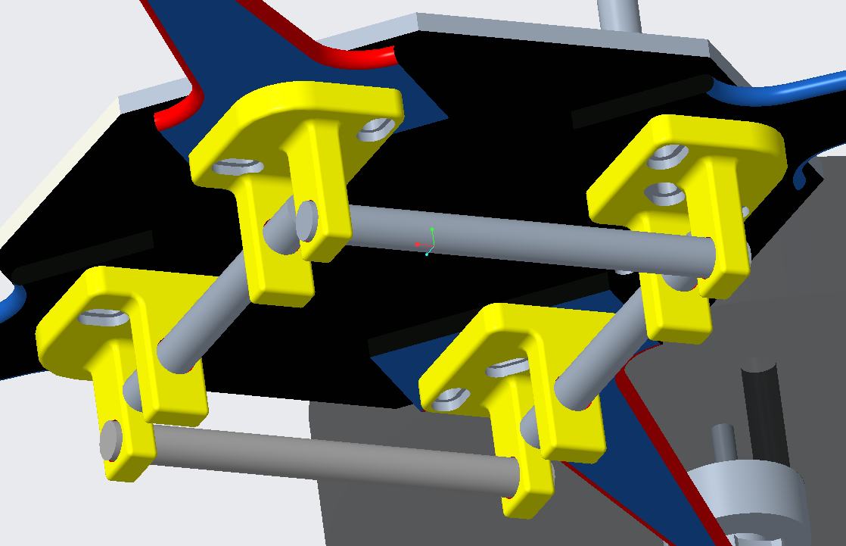
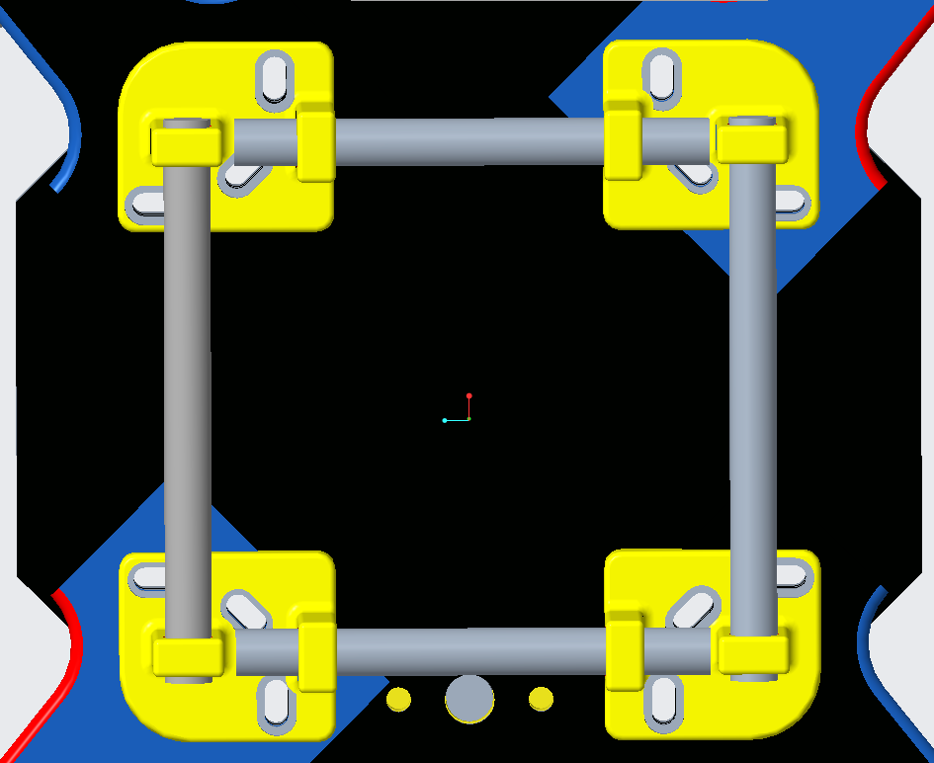
2. Tactical Rail System (TRS)
Component and cargo carrying system
Rail bracket
2 rail connection points for components
Slotted attachment points to frame
Increase connectability
Rail
Brass -> Aluminum (67% weight reduction)
Component | Beginning Weight (g) | Final Weight (g)
PLA Bracket | 31.4 | 32
Rail | 36 | 11.6

Slide 14
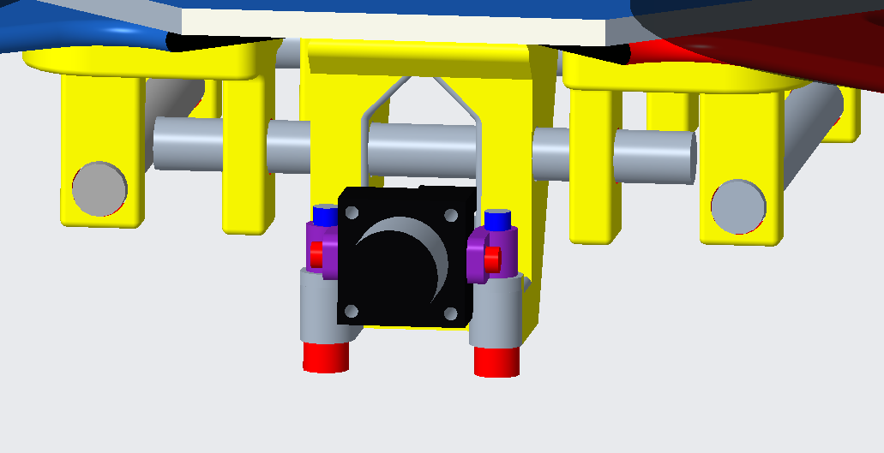
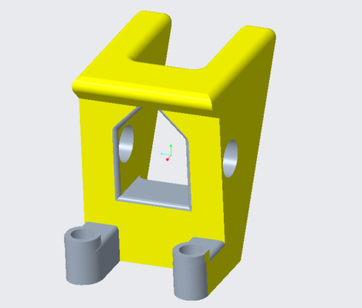
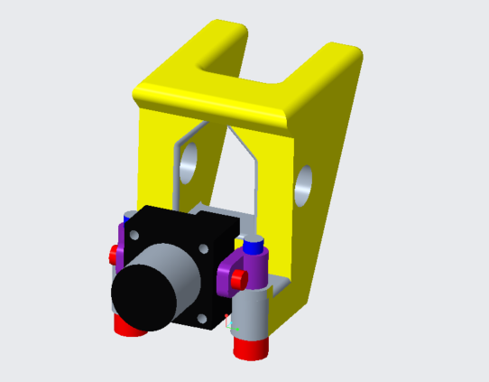
3. Tactical Camera Mount (TCM)
Firm attachment point with ability to adjust camera angle
3 Piece Design:
Camera with side mounts
8mm bolt
TCM bracket
Component | Beginning Weight (g) | Final Weight (g)
PLA TCM | 43.3 | 27.6

Slide 15
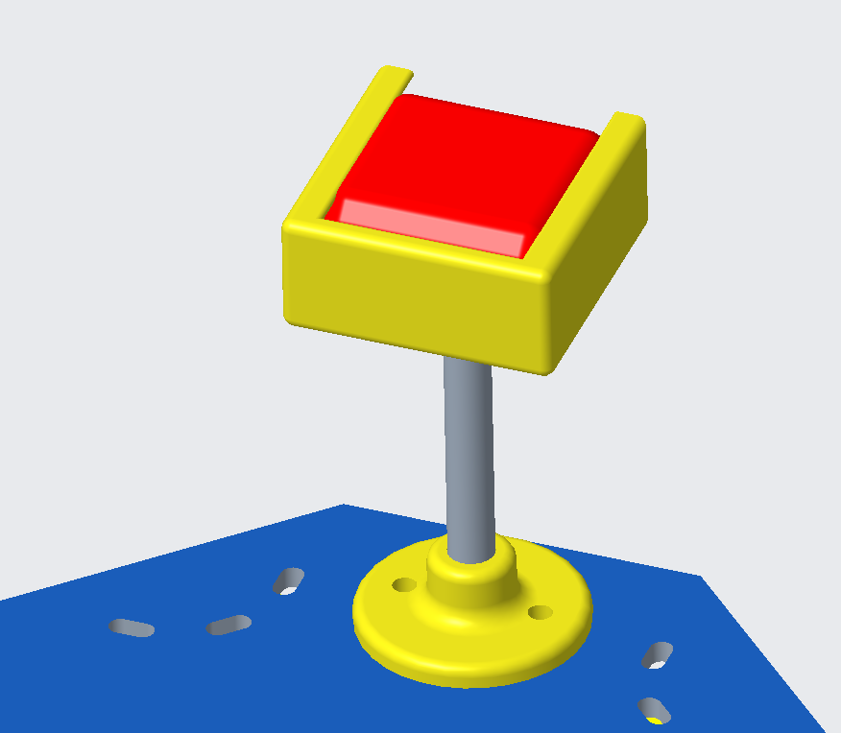
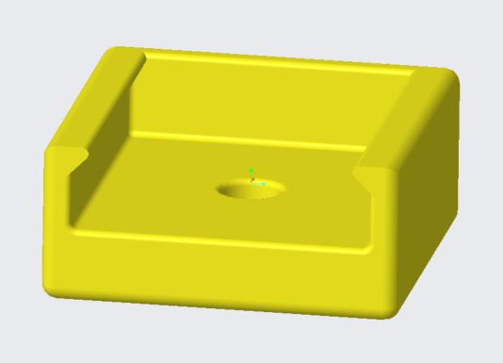
4. Tactical GPS Mount (TGM)
Secure attachment point for GPS with 5 cm clearance
3 piece construction:
Top GPS sleeve
5cm Aluminum rail
Bottom rail - frame bracket
Component | Beginning Weight (g) | Final Weight (g)
PLA Top Sleeve | 8 | 8
5 cm rail | 3 | 3
Rail - frame bracket | 3 | 3
GPS | 21 | 21

Slide 16
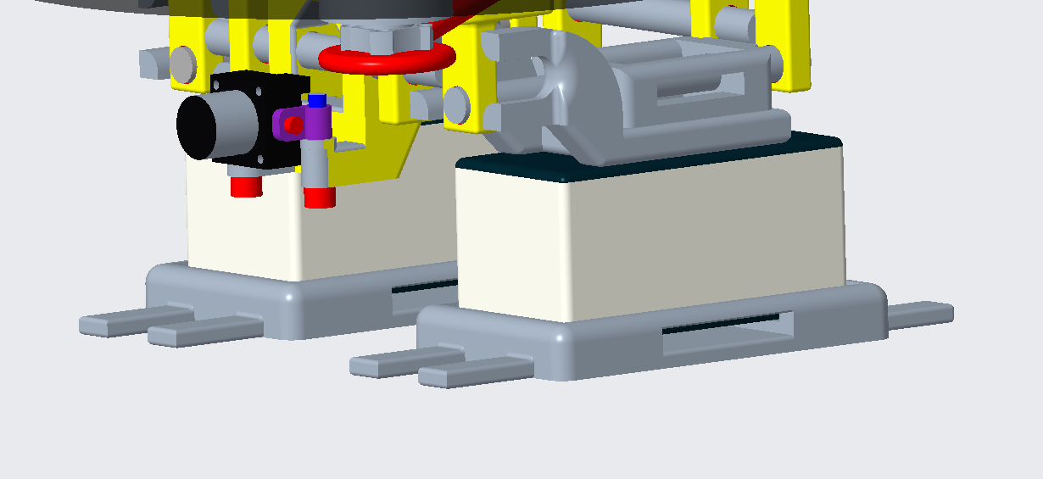
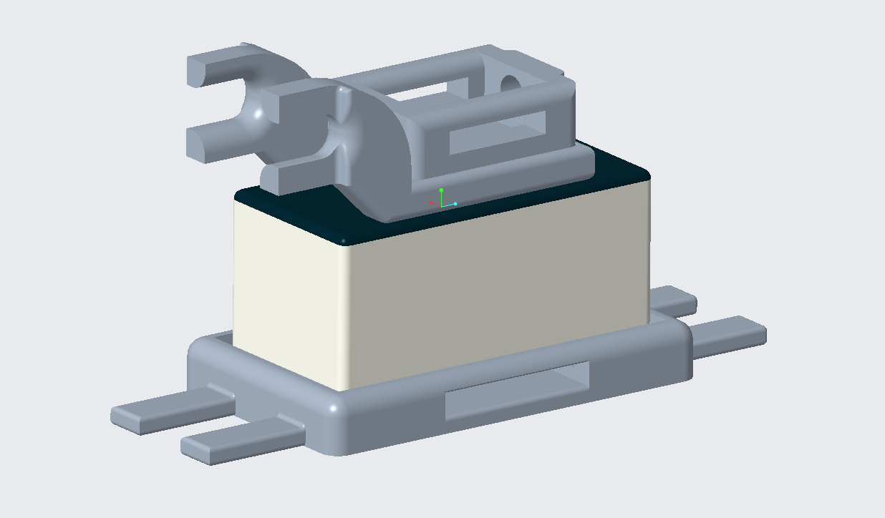
5. Battery Holder / Landing Gear (BLG)
Puncture resistant attachment point for battery and landing surface for drone
3 piece construction:
Top ABS bracket
Battery and elastic strap
Bottom “foot” bracket
Component | Beginning Weight (g) | Final Weight (g)
ABS Top Bracket | 55.8 | 52.6
Battery | 200 | 200
“Foot” bracket | 59.8 | 60

Slide 17
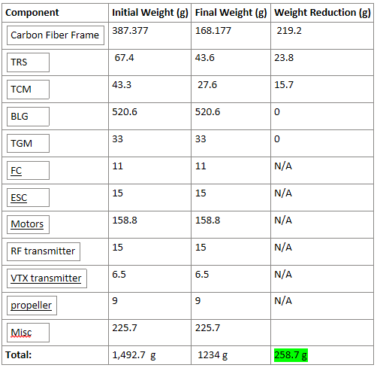
Overall Weight Map

Slide 18
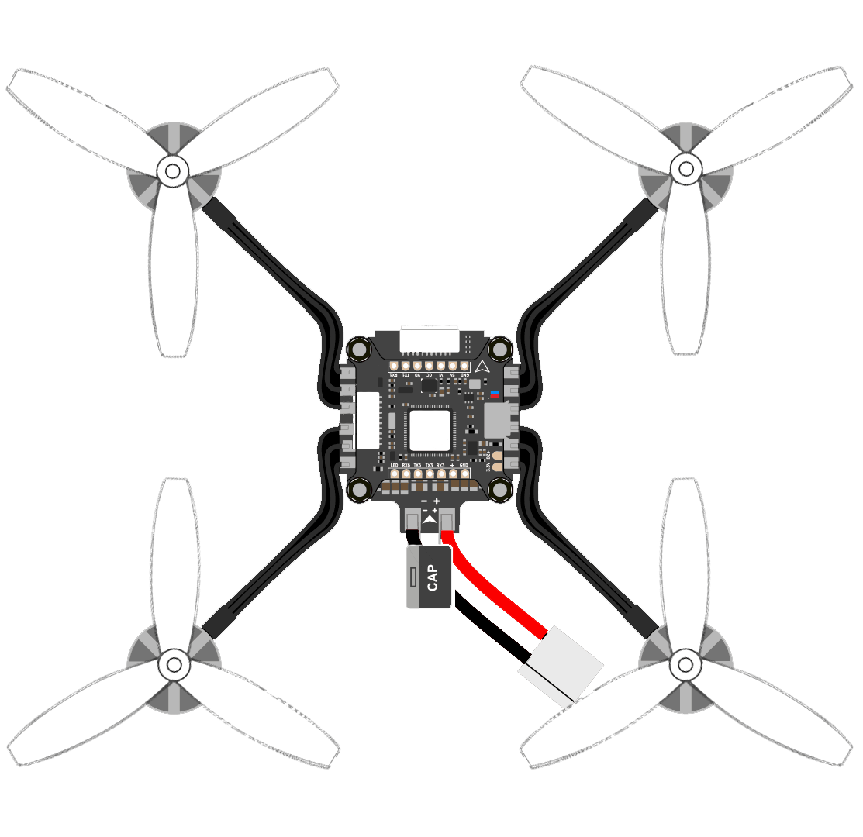
Thrust System Components
Goal - minimize the weight and power use to get maximum flight time
Must produce adequate thrust
Must be cost efficient
Components for the thrust system:
Motor
Propeller
Electronic speed controller (ESC)
Battery
Notes:
The goal of the thrust system was to get the max out our flight time, while having enough of a power overhead to lift cargo
We also wanted this system to be easy on the budget
Explain diagram

Slide 19
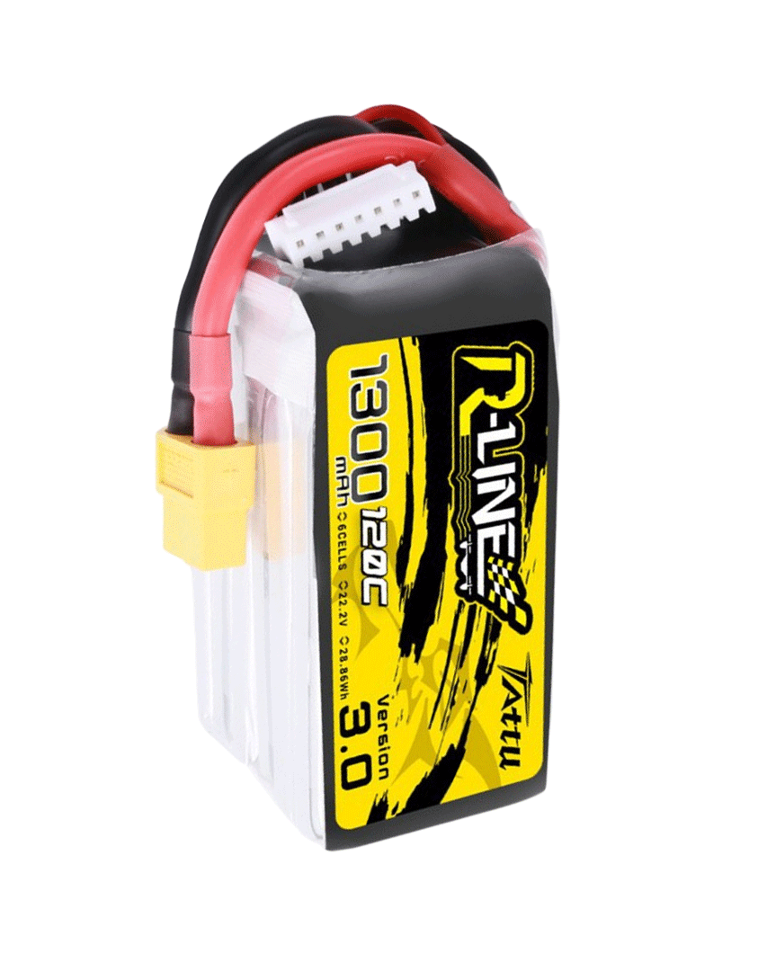
Battery
Tattu R-Line
LiPo (Lithium Polymer)
6 1300 mAH cells
25.2V
220g each
We will run multiple batteries in parallel
Given more time and budget we would build custom Lithium-Ion
Notes:
First up is our battery for the drone
To be easy on our budget we used the Tattu R-lines that I use for my racing drones
These are lithium polymer batteries, with a decent energy density and excellent ability to dish out that energy
These are specifically 6, 1300 milli-amp hours cells that put out 25 volts
They weigh in at 220 grams each and we can run multiple in parallel to increase our energy capacity
If we had more time and budget we would build custom Lithium-Ion batteries
These have higher energy density at the trade off of lower amp draw, but should still be sufficient for our drone

Slide 20
Motors / Propellers
Motor Name | Motor Size | Weight (g)
F40 | 2205 | 123.2
F60 | 2207 | 134
F80 | 2407 | 158.8
F90 | 2806.5 | 186.4
Prop Length (in) | Two-Blade Weight (g) | Three-Blade Weight (g)
5 | 12.4 | 15.2
6 | 20.4 | 25.6
7 | 26.4 | 36.4
8 | 30.8 | 44.2
T-Motor Brand
Motor size XXYY
XX - Stator diameter in mm
YY - Stator height in mm
Prop
Length (Diameter)
Blade count
Notes:
The next variable are the size of our motors and the length and number of blades on our propeller
We specifically tested with the T-Motor brand of motors since they have an excellent range of all the standard sizes of motors and their excellent build quality
The motors listed are sized by the first two digits being the diameter of the stator in mm, and the last two digits being the height
For the prop length we have a range from 5-8 inches, and two blade and three blade configurations
And of course all of these parts have their own weight that will be included in the flight time calculation
Using all these variable i made 64 flight time calculations and was able to draw some conclusions from that data

Slide 21
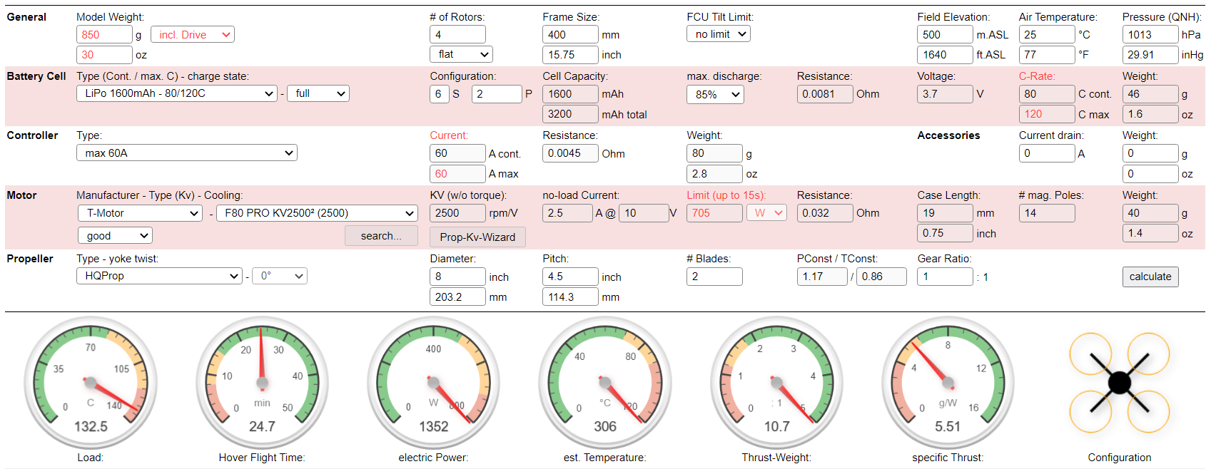
eCalc
Notes:
eCalc was the tool I used to help determine what the best setup for our drone would be
This tools allows you select the components and specifications of the drone. And it will calculate the flight time for you

Slide 22
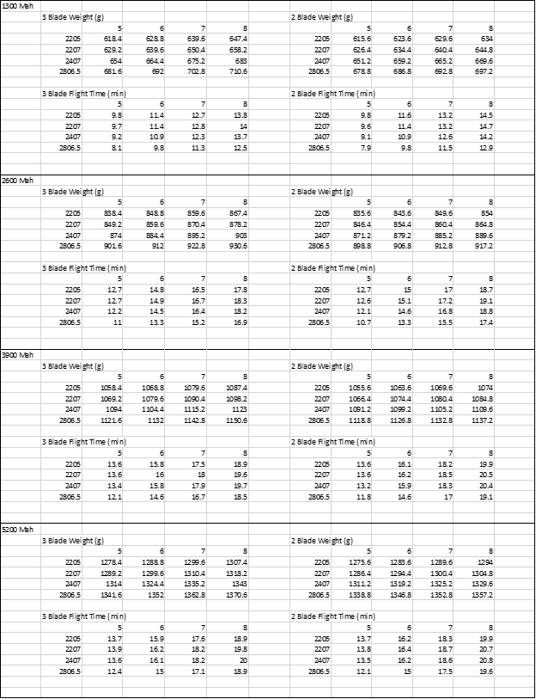
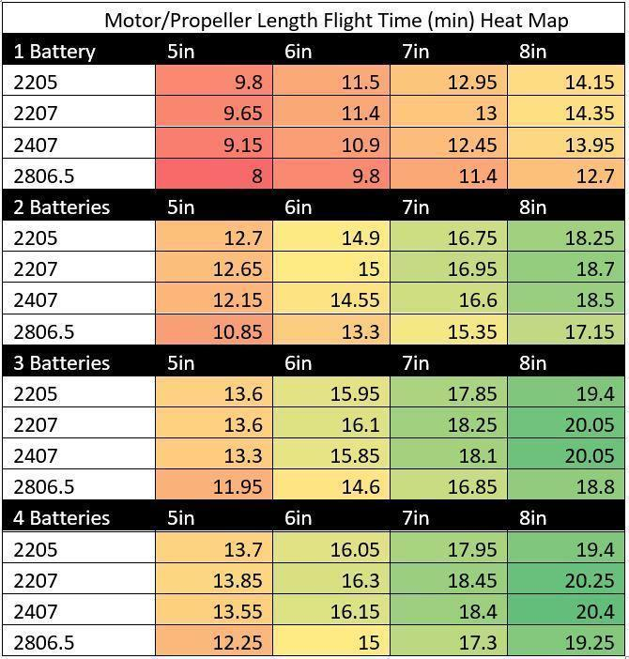
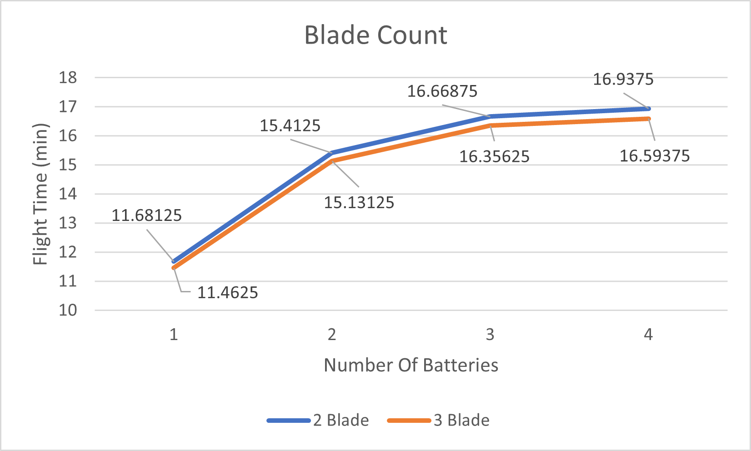
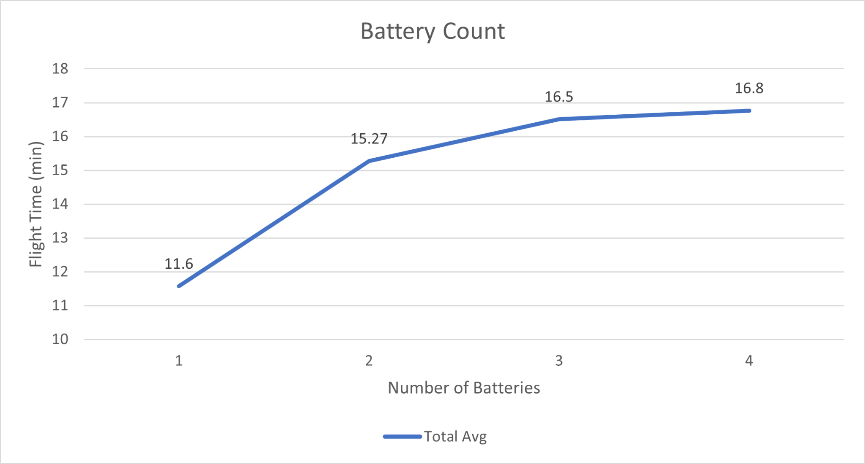
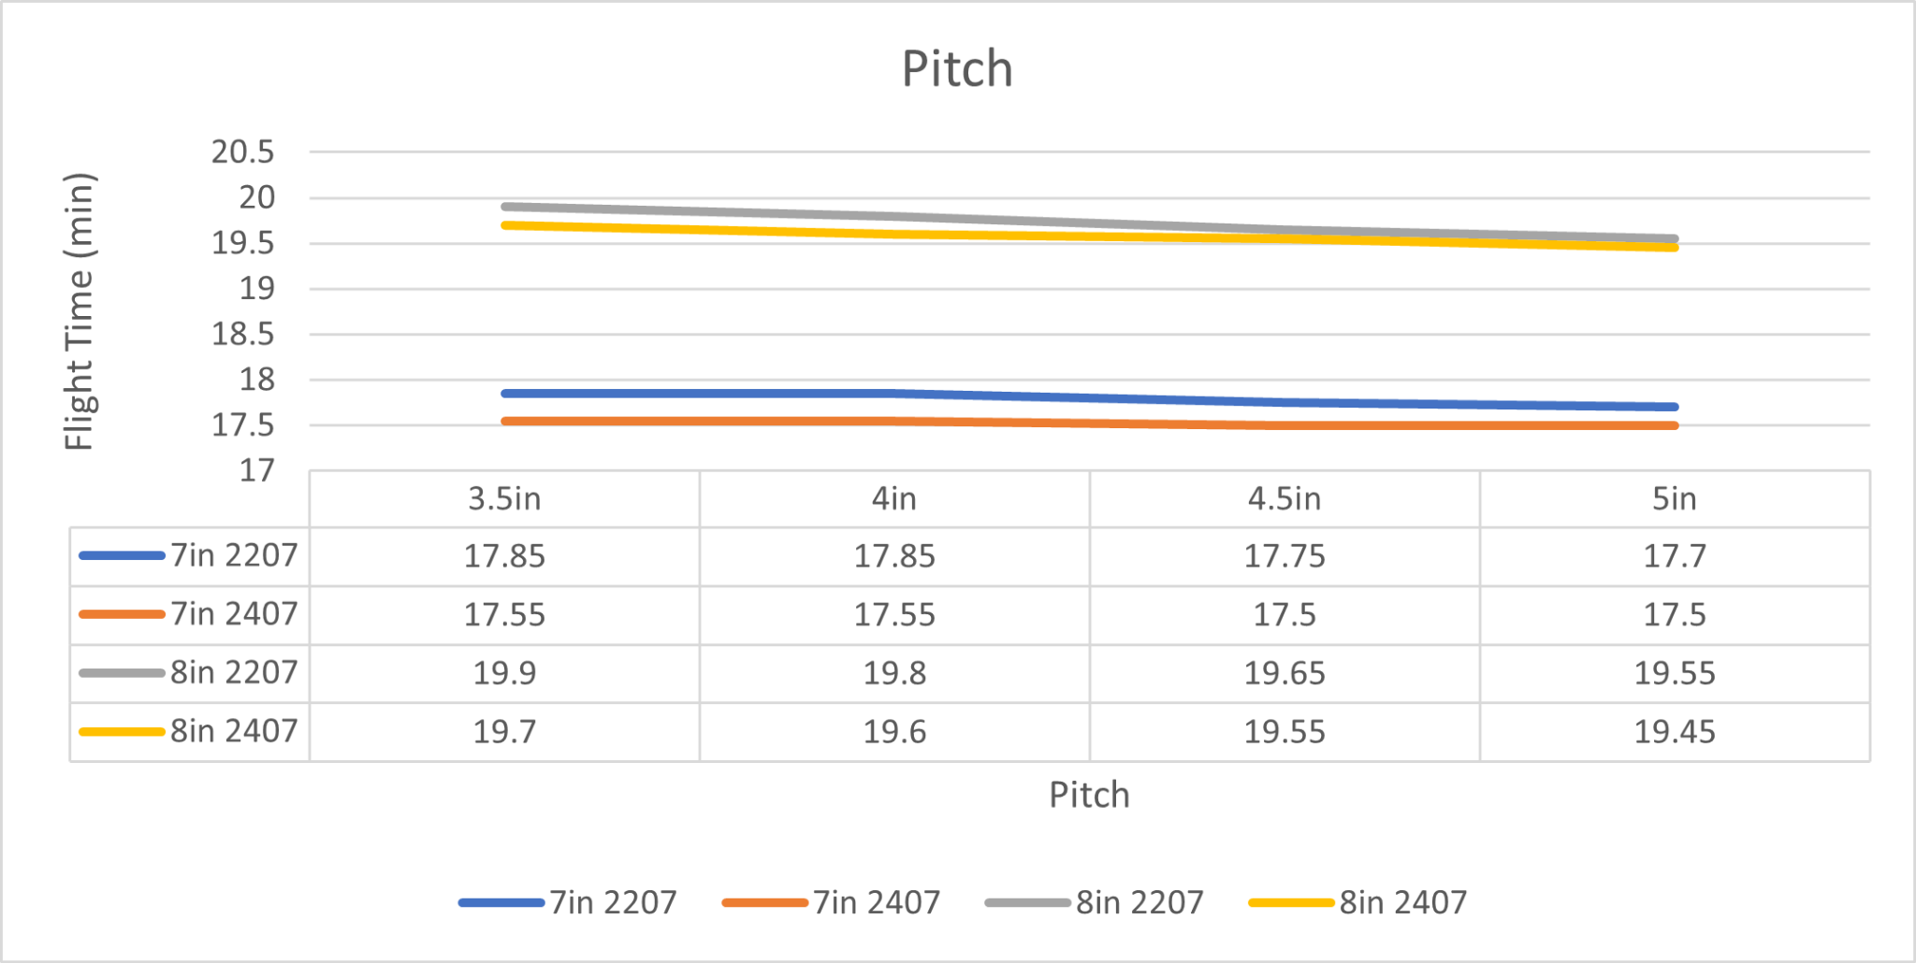
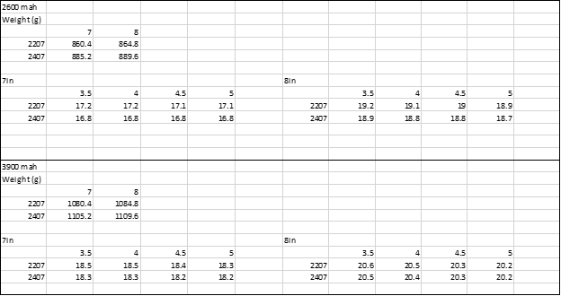

Slide 23
Variable Relationships
Propeller length increases
Efficiency increases
Efficiency of larger motors
Weight from more batteries
Efficiency of larger motors
Largest motor never becomes efficient
Steep diminishing returns on batteries
Notes:
Next we have a heat map our configurations
From the data i was able to conclude that as propeller length increased, the overall efficiency increased
The amount of this increase was higher for the larger motors than the smaller ones
This also held true as we increased the weight of the drone with more batteries.
This is because the larger motors have more torque to overcome the greater resistances when compared to the smaller ones
There are also diminishing returns on flight time as we add more batteries
However, we never reach a point where the largest motor becomes more efficient

Slide 24
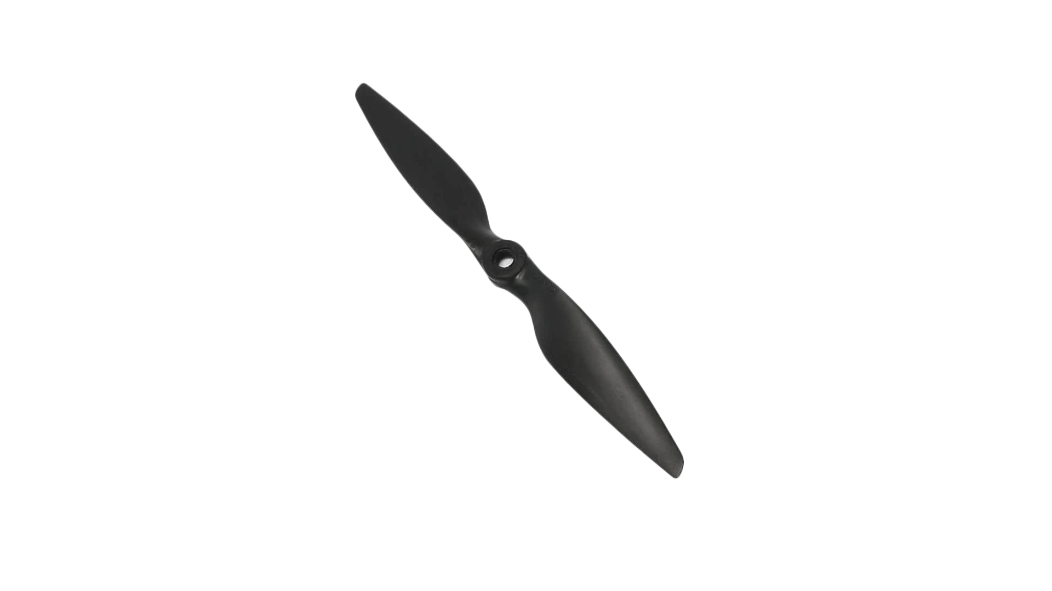
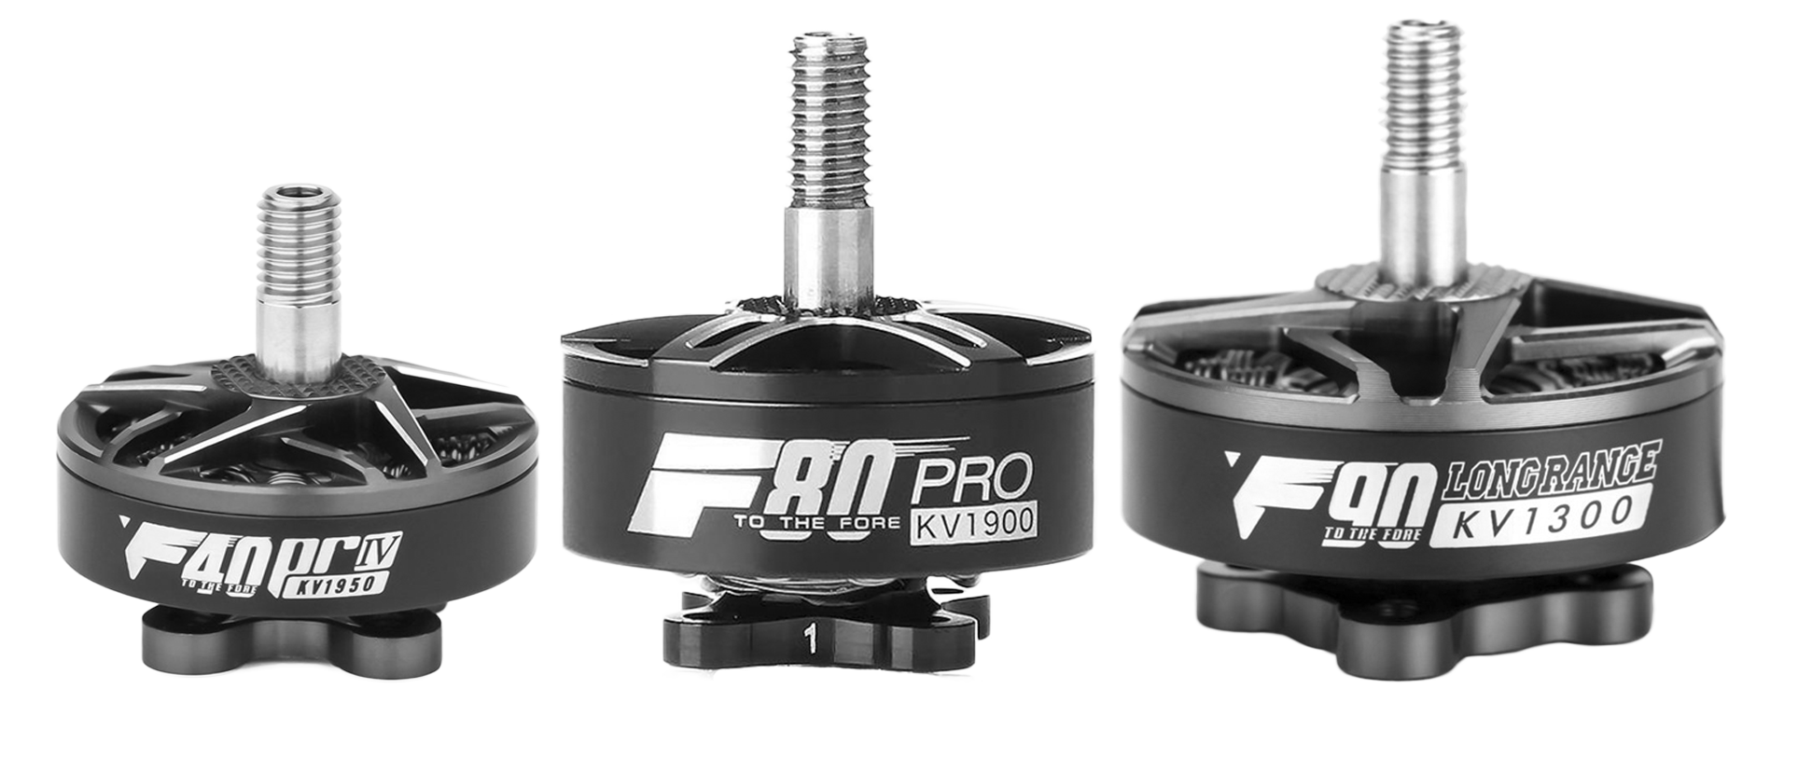
Final Selection
F80 - 2407 Motor Size
Becomes more efficient than 2207 with weight
More torque to spin a larger prop
2 Batteries
Diminishing returns
Meets requirements
Space
8in 2 Blade Prop
Most efficient
Why Not Larger?
Availability
Scale
Notes:
From this data i had to them make my final decisions on components
For the motor i went with the 2407, the second largest motor
This motor will give us a long flight time and enough power to lift additional weight
We went with 2 batteries for our build
We were able to meet our flight time requirements with just 2 and because of the diminishing returns and the effects on the space and balance of the drone we saw no reason to add more
And finally the 8in 2 blade prop was the most efficient being the largest prop we tested
The reason why we didn’t test a larger prop was because of the scarce availbility of larger props and props often break meaning you’ll have to be able to get more
Also the next more available prop being a 12 inch means the scale of the drone would become too large and not portable enough for SAR teams

Slide 25
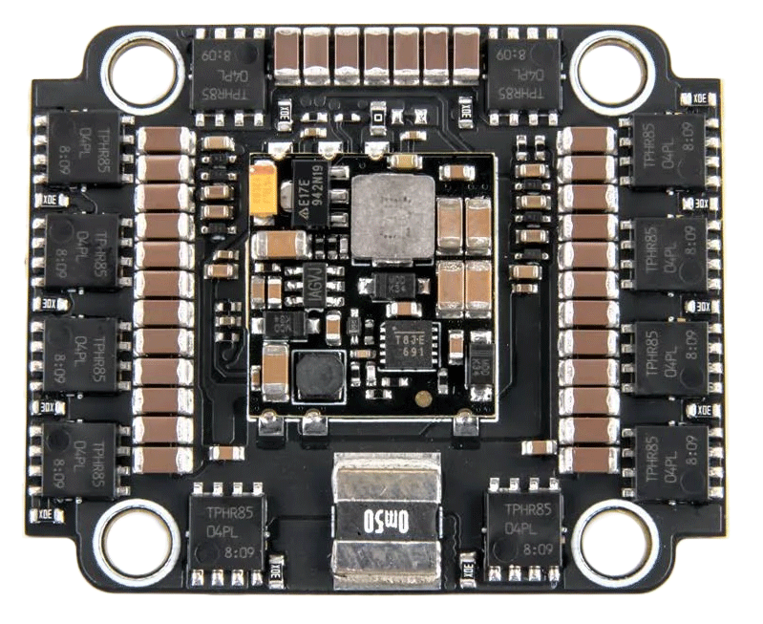
Electronic Speed Controller
Requirements
Rated for 25.2 Volts
60A draw
4-in-1 instead of 4 individuals
Replaces Power Distribution Board
Saves 30g
More susceptible to ESC fires
Aikon AK32
Notes:
The final piece of the puzzle is the ESC
Our ESC must be rated high enouogh to deliver power to our motors
It must be capable of the 25V our batteries put out while also being able to handle the max output of our motors which calculated by eCalc was about 60 amps
We also decided to use a 4-in-1 ESC over individual ones because of the weight savings of this board, and the fact that it will also act as a power distribution board as well
The only downside of a 4-in-1 is if you have an issue with an ESC, you must replace all 4 of them

Slide 26
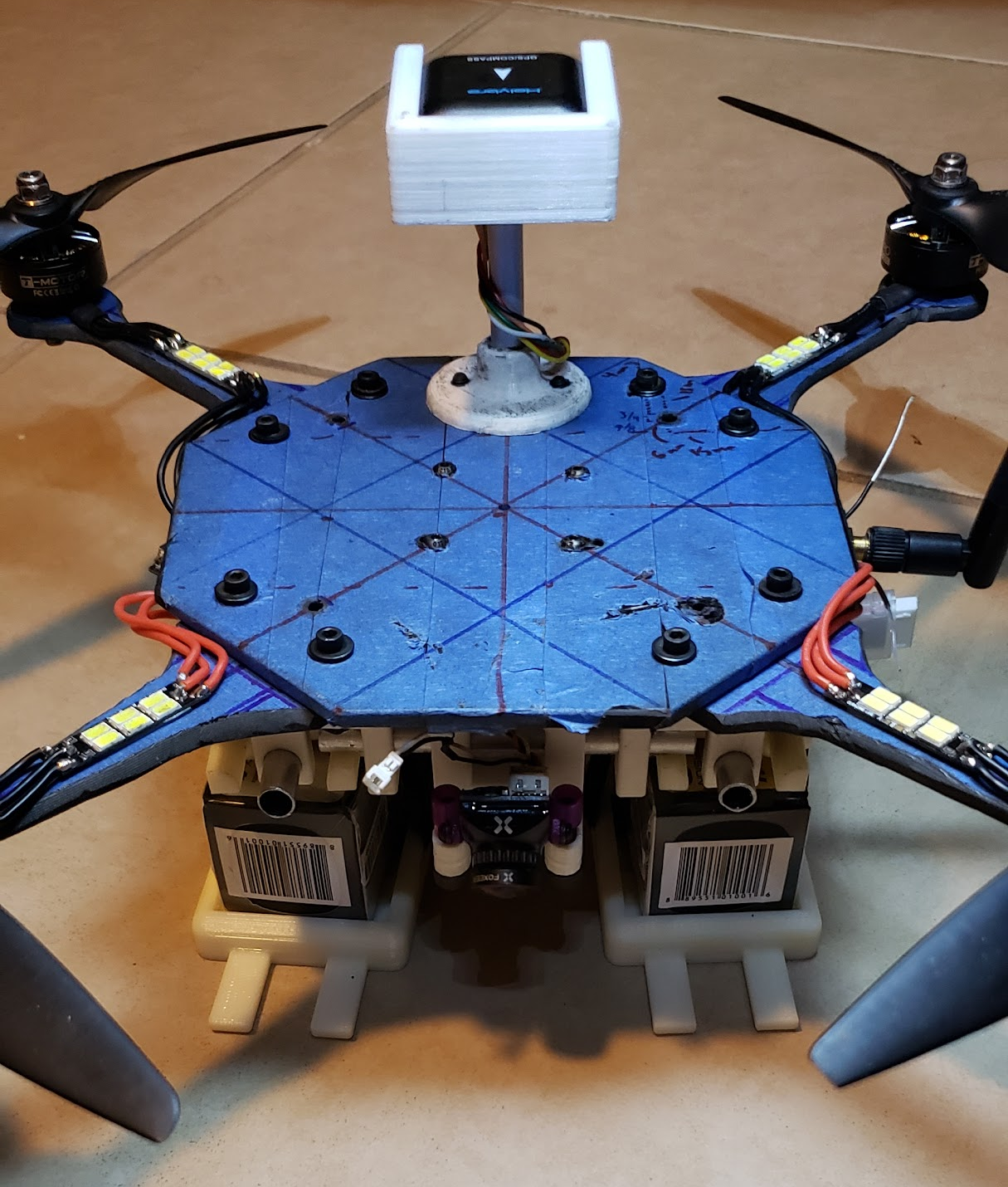
Project Status
Flight Time of 12 Minutes
Achieved 12.9 Minutes
Max speed of 15mph
Achieved > 40mph
Carry up to a 1 pound of cargo
7:1 Power to Weight Ratio
Drone Weighs 2.7lbs

Slide 27
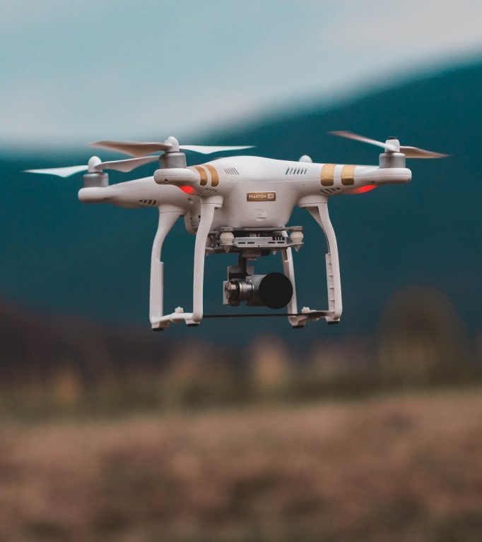
Automation
Notes:
Speaking: Chris, Moises, Lisa

Slide 28
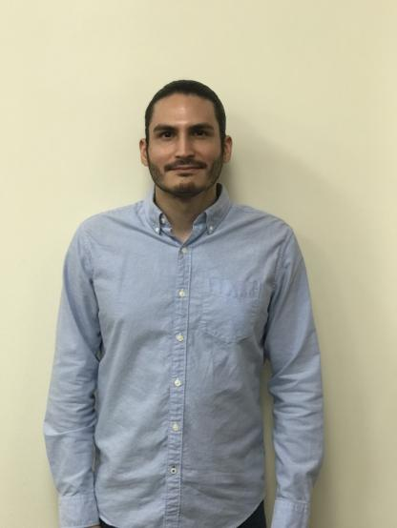

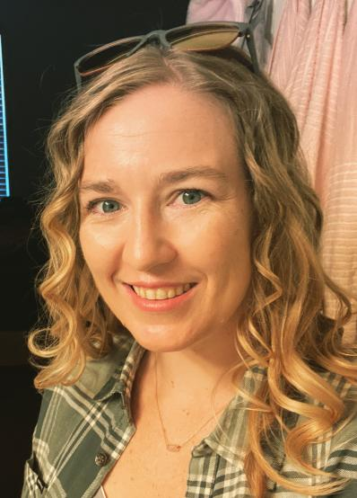
Automation System Members
Moises David Cortes Lugo (CpE)
Backend Automation
Christian Lozano (CS)
Flask: Backend/Frontend
Lisa Harrison (ME)
CS/IRS Minors
Search Algorithm & Pattern

Slide 29
Automation System Requirements
Drone must be autonomous
Little to no human involvement
Must operate even when offline
Must have interactive UI
Define search perimeter, launch drone, emergency control, etc.
Notes:
Split into the beginning of each system?
Specify that UI needs internet and not drone

Slide 30
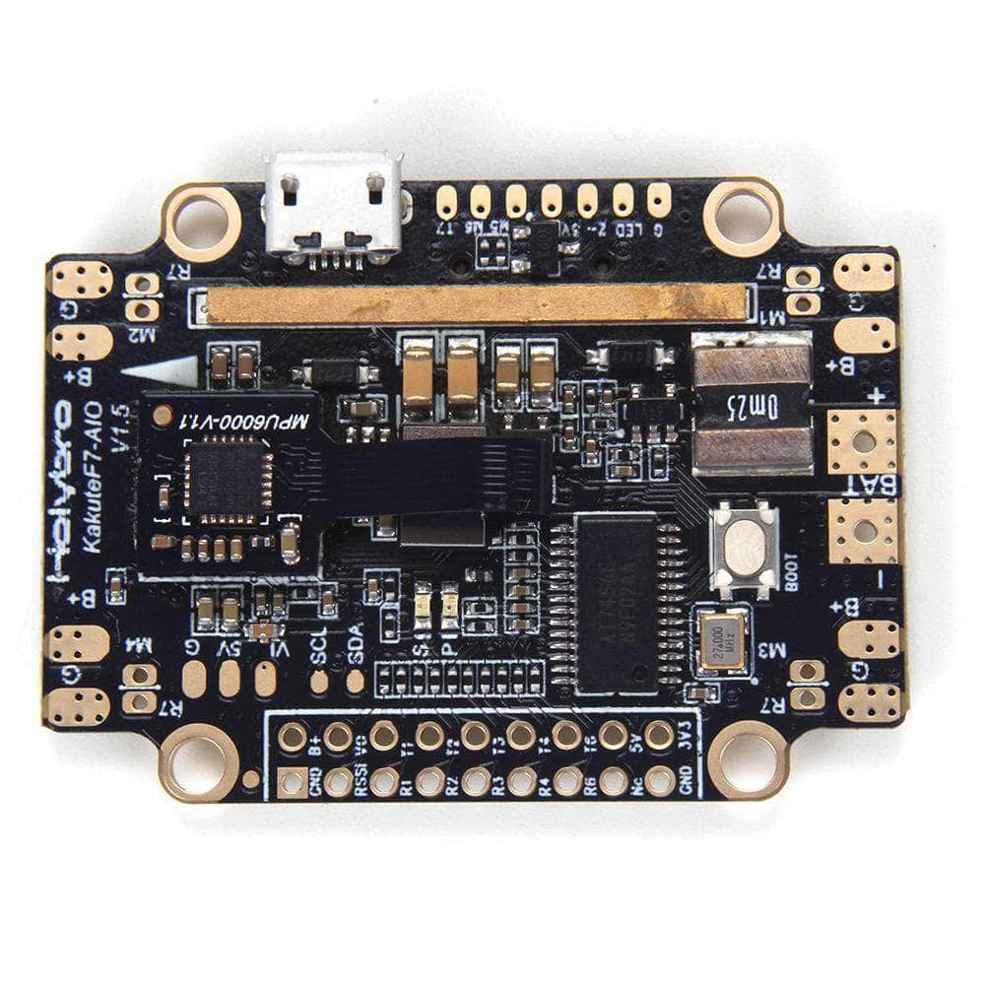
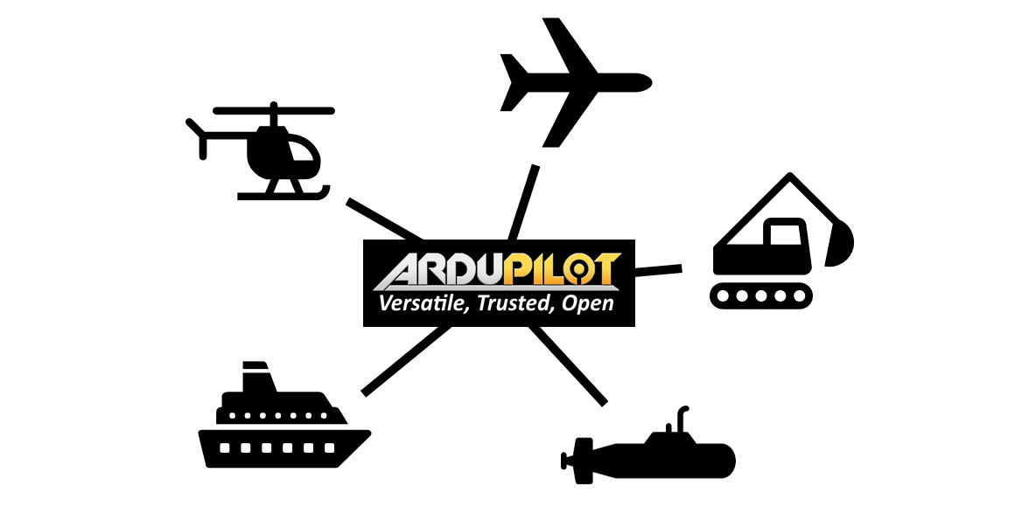
System Software & Flight Controller
Ardupilot
Holybro Kakute F7 AIO
Provides open source firmware for Flight controller
Compatible with many GCS
Supports GPS navigation
Available since 2009
Compatible with Ardupilot
MCU: STM32F745 (CPU 216MHz, flash 1MB)
7 UART ports & I2C support
6-axis Gyro and Accelerometer, & barometer(height)
Lightweight: 11.2g
Notes:
GCS

Slide 31

Drone Integration: Backend Technologies
DroneKit is the Python-based API used to write the automation
It allows the drone to fly by itself from waypoint to waypoint
MAVLink is a protocol used to establish communication between the drone and its onboard components
MavProxy is a Ground Control Station (GCS)
It connects to the drone over a radio frequency antenna, and opens a UDP port for our program to connect to
Notes:
Speaking: Moises (mention that it runs on FLASK backend)

Slide 32
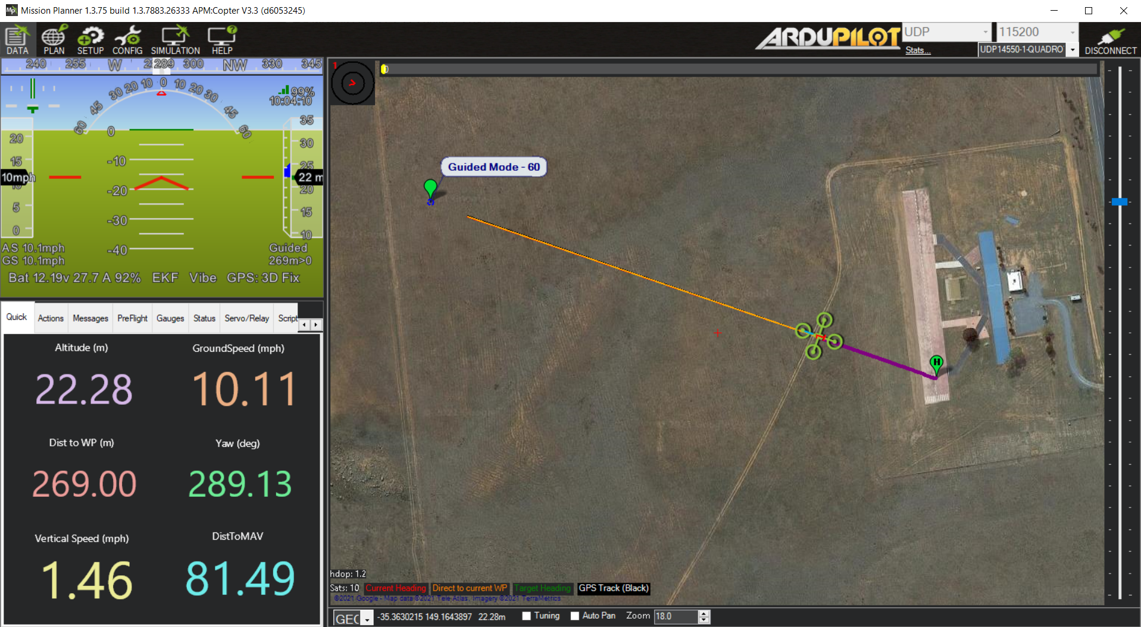
Software Development
Mission Planner
GCS runs alongside Mavproxy
Useful for monitoring drone
Dronekit SITL (Software In The Loop)
Software provides virtual drone

Slide 33
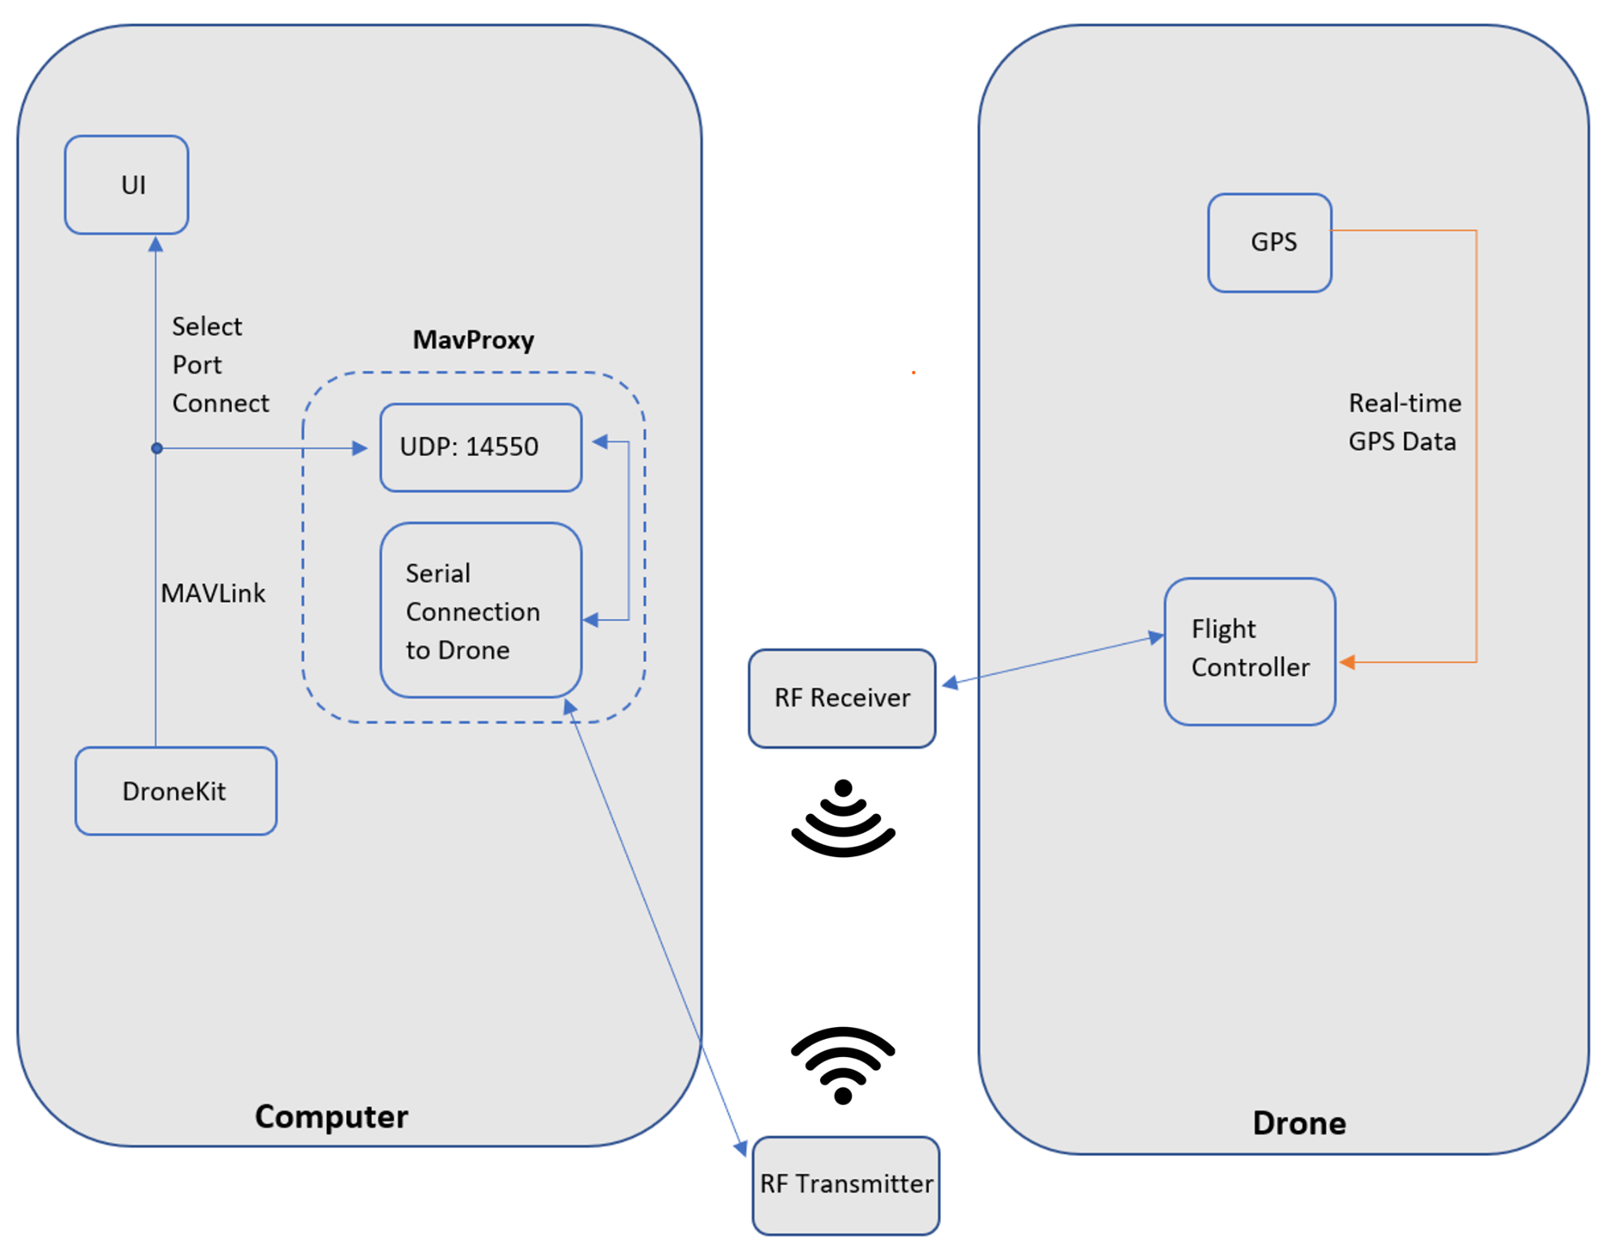
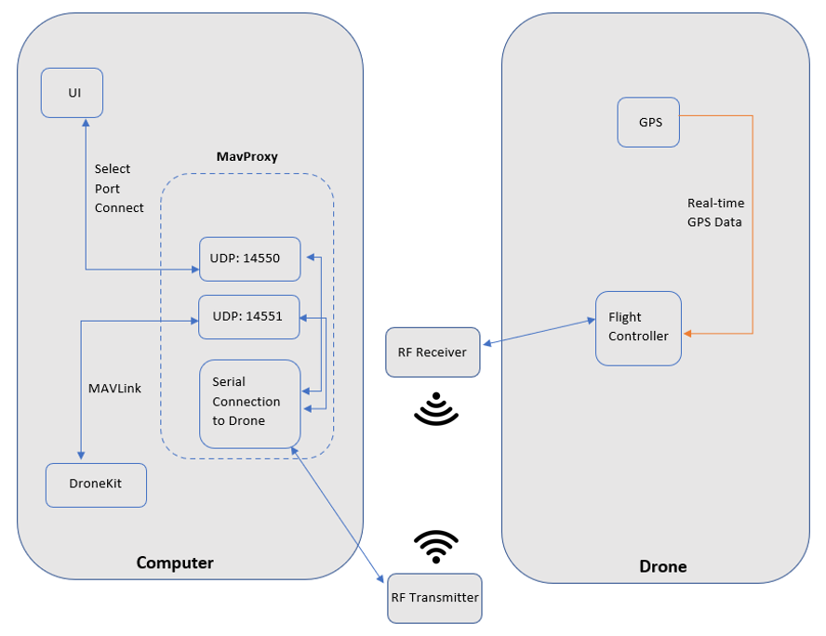
Automation System Diagram
Notes:
How’s this draft look, Moises?

Slide 34

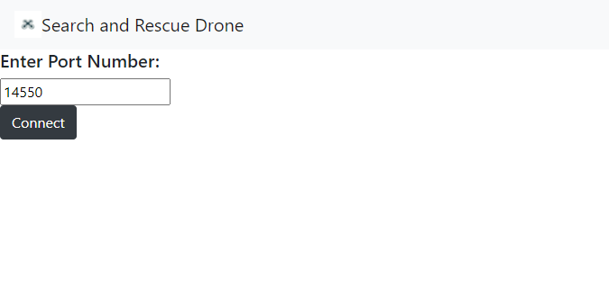
The UI
Developed in Flask
Compatibility (runs off Python, which connects to backend & CV script)
Runs locally, allowing to read COM ports on the PC for telemetry
User process
The user will type the port number the RF is on and then click connect
Next the user will click 4 points on a map to make a rectangular or square shape to search
Finally, the user will click submit to begin the search
Notes:
Speaking: Chris

Slide 35
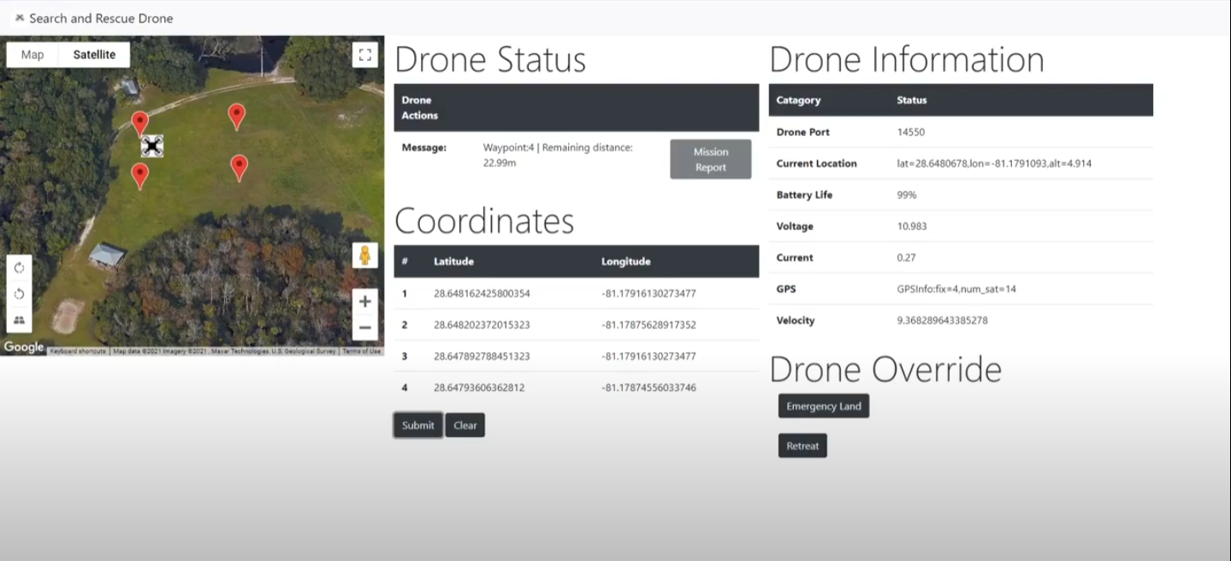
Main User Interface
Table that displays the selected points on the map interface
Drone icon updates on a time interval bases to show latest position of it
Telemetry Info Table
Drone ongoing actions
Drone Override functions
Notes:
Speaking: Chris

Slide 36
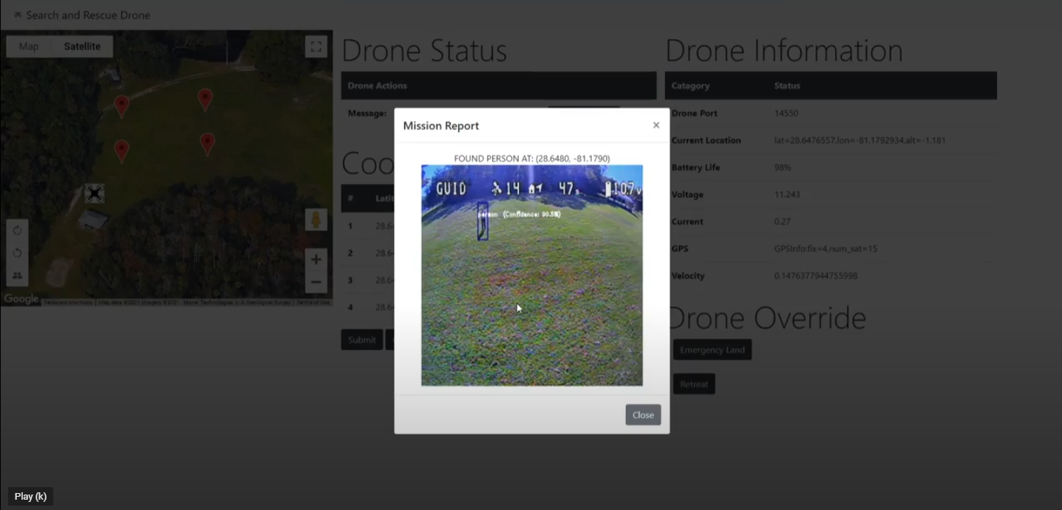
Mission report:
Main User Interface Cont.
Shows coordinates of person found
And image of the high confidence page
Notes:
Speaking: Chris

Slide 37
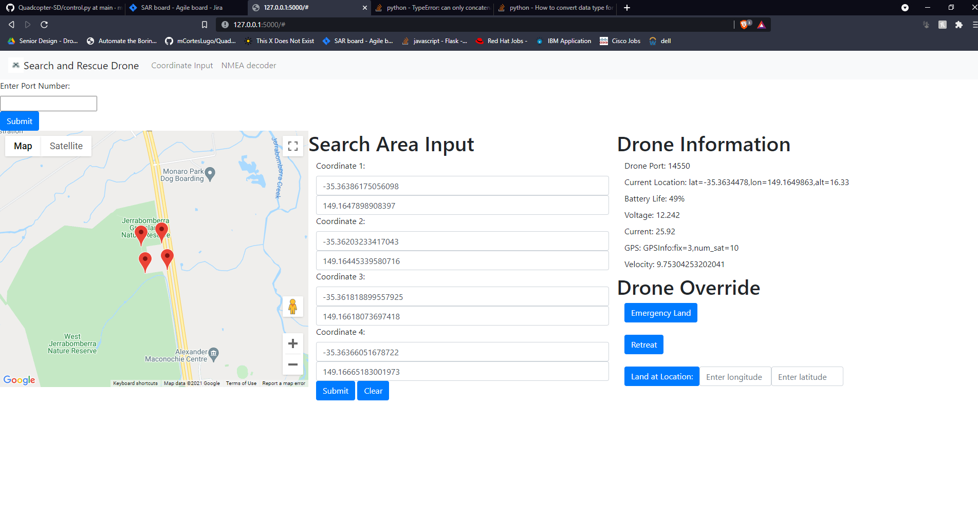
UI Changes
Old UI
New UI
Refined the aesthetic of the application
Added mission report and status messages
Added drone icon that updates to the real time location
Changed coordinate input to clicking on the map instead of typing them individually
For visibility shows selected coordinates selected on the side
Notes:
Speaking: Chris

Slide 38
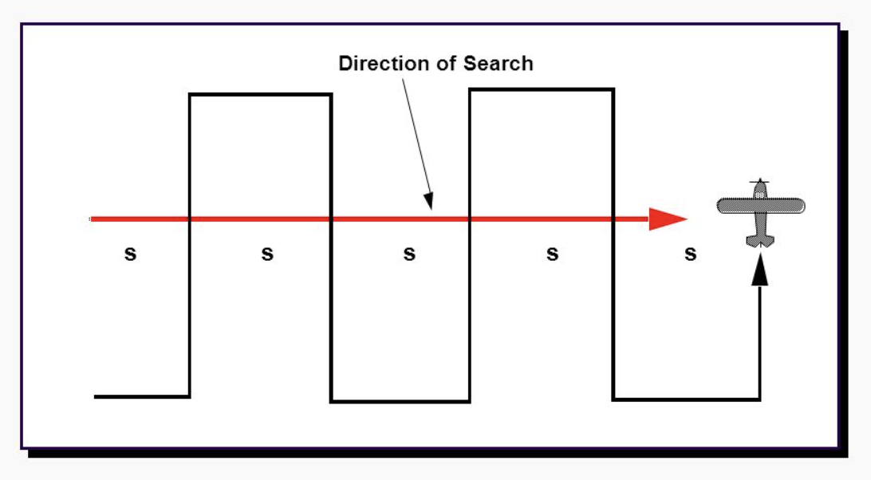
Search Pattern & Algorithm
Algorithm has to move the drone in a way that allows the camera to visualize every part of the search area
Parallel search pattern
Interval between search paths is determined by the FOV of the camera
Incorporates the area of the CV algorithm that has the highest probability of detection
Searching the most likely route is efficient for ground teams
Saves drone for search patterns that are more manpower-intensive
Notes:
Speaking: Lisa
Also, I abbreviated “mow the lawn” to “MTL” to allow for more space

Slide 39


Search Pattern & Algorithm
Parallel search algorithm requires a perfect rectangle for waypoint generation
Program generates a perfect rectangle from the user coordinates
This pattern allows for the greatest flexibility for user input
When the last known point (LKP) of a human is generally known, the user can define the search area to situate the LKP in the middle
The user can also extend the search area in the likely direction of travel
Notes:
Speaking: Lisa
Also, I abbreviated “mow the lawn” to “MTL” to allow for more space

Slide 40

Computer Vision
Notes:
Speaking: Josh

Slide 41

CV System Members
Josh Mutugi (CS)
CV Model Selection
CV Model Integration
Notes:
Whoever put this picture here - it’s honestly hilarious.
System diagram
Onboard vs Offboard
Component Selection

Slide 42
CV System Requirements
Must detect a human from an altitude of 10 - 15 ft.
Must detect a human within its frame with at least 80% confidence
Model must run quickly on CPU
Model preferably has pre-trained weights
Training would take a long time on CPU
Model has simple implementation
A long, complex process would not be feasible
Notes:
Speaking: Josh

Slide 43

Some Possible Object Detection Models
HOG (Histogram of Oriented Gradients)
Focuses on the structure and shape of the object in the image by calculating the orientation and gradient of each localized portion
EfficientDet
Extracts features from the image, classifies them, and fuses them together to predict the object
YOLO (You Only Look Once)
Divides the image into a grid and predicts the class, bounding box and confidence for each object
YOLO Object Detection Design
Notes:
Speaking: Josh

Slide 44

Comparison of Available Models
Initially, we used HOG, but found it detected too many objects incorrectly
YOLOv4 runs twice as fast as next most efficient model
Quickly found YOLOv4 pre-trained weights after a few Google searches
Also found an OpenCV-based script to test it with live footage
Notes:
Speaking: Josh

Slide 45

Our Current CV Model
Running YOLOv4 on CPU was very slow
Operated at 1 - 3 Frames per Second (FPS)
Research showed that Tiny YOLOv4 was a compressed version of YOLOv4
Typically used with mobile and embedded devices, making it lightweight
Quickly found Tiny YOLOv4 weights after a Google search
Running Tiny YOLOv4 on CPU was relatively fast with a slight drop in confidence
Operated at 6 - 11 FPS with a ~5% dip in confidence
We settled on Tiny YOLOv4, deciding the drop was negligible
Notes:
Speaking: Josh

Slide 46


Onboard vs. Offboard Processing
NVIDIA’s Jetson Nano for Onboard CV Processing
FPV Receiver for Offboard CV Processing
Onboard processing produces high video quality, but demands more battery consumption while adding more weight and space to the drone
Offboard processing produces adequate video quality, but it is cheaper with fewer necessary components
Notes:
Speaking: Josh

Slide 47


Components
Camera
VTX (Video Transmitter)
Foxeer T-Rex
Highest resolution analog camera on market
1500TVL 2MP
150° horizontal field of view
RDQ Mach 3
Heat protection lasts for an hour
Others will burn in minutes without airflow
Capable of the highest power output for most VTX
Mile range for video
Notes:
Speaking: Josh

Slide 48

Computer Vision System Map
Notes:
Speaking: Josh

Slide 49

Demo

Slide 50

Administrative

Slide 51



Administrative Technologies
Discord
Team communication
Jira
Project management
GitHub
Updating code
Notes:
Github jira etc

Slide 52
Project Management - Agile
Short term, working deliverables with quick feedback
What we implemented:
2-Week Sprint planning meetings
Weekly scrum (stand up) meetings
What worked for us:
Short-term focus
What didn’t work for us:
Long-term focus
Thinking outside of current sprint
Notes:
Github jira etc

Slide 53

Project Management - Agile
Notes:
Github jira etc

Slide 54
Drone Budget
Part | Cost ($)
Flight Controller | 48.99
Electronic Speed Controller | 49.99
Video Transmitter | 24.99
RF Telemetry Module | 29.00
GPS | 39.90
Camera | 44.90
Motors | 107.96
Propellers | 7.55
Batteries (One Set) | 73.98
Frame | 66.23
Total Cost | 493.49
ME Department Paid (Including price of items already in stock) | $345.73
What We Already Had | $73.98
Teams Total Expenses | $66.23
Notes:
Lisa

Slide 55
Challenges & Successes
Challenges
Successes
Lack of a sponsor
Mentors in Dr. Stresau and Dr. Leinecker
Being a multidisciplinary project (& constantly verifying schedules)
Drone caught on fire
Yet, somehow managed to work better afterwards
Project Management Software
Jira
Weekly Meetings
Team-wide
Dr. Stresau (MAE SD)
Communication Platforms
Discord
Notes:
Lisa

Slide 56
Increased Scope
Swarm (multiple) drone setup
Project was designed to be inexpensive to support multiple drones
Thermal imaging onboard sensors
Add payload support for supply delivery
Custom waypoints
Multiple victims

Slide 57

THANK YOU

